Slide 1

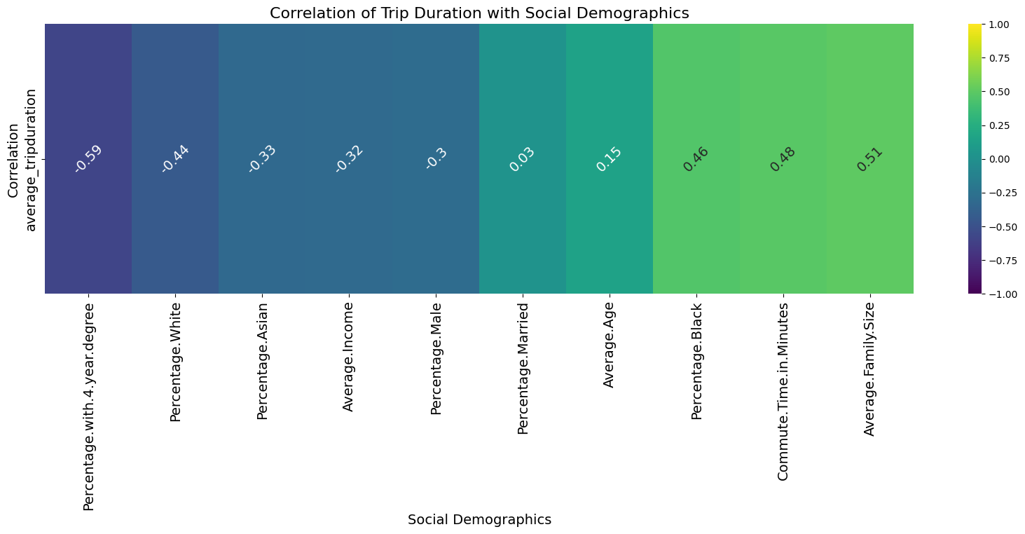
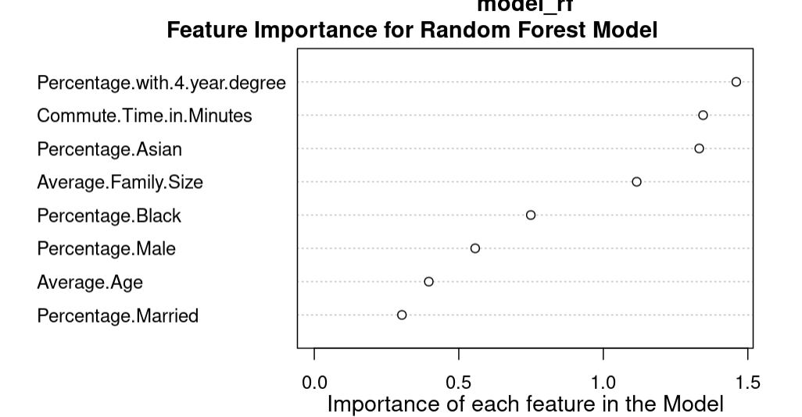
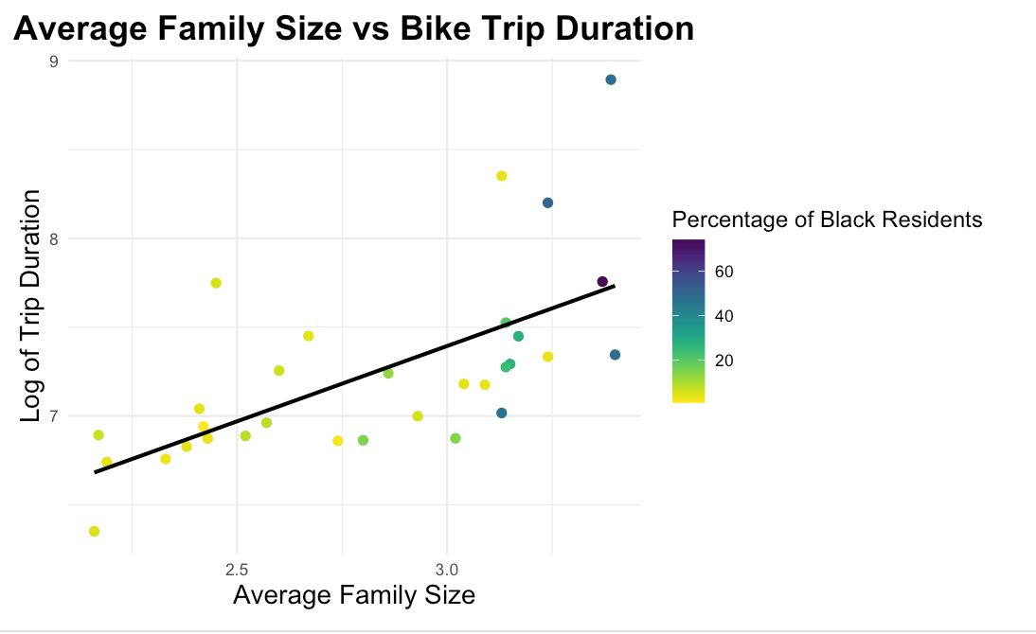
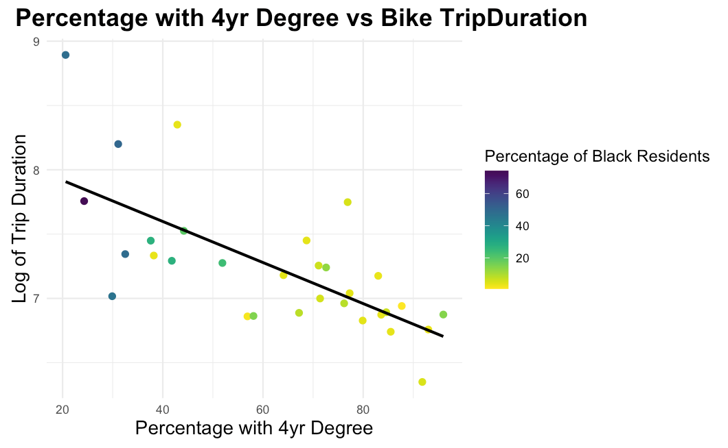
Relationship of Blue Bike trip duration and Boston neighborhood demographics
Jasmine Le 2025 Data Science Capstone Project
Introduction
Visualizations
Results
Research Question
Running three different models, a first order linear regression, KNN, and Random Forest. Random Forest performed the best on all three measures.
How does trip duration vary across different neighborhoods in Boston, and is there a relationship between the demographics of a given area and the duration of bike trips? Can we predict based social demographics of one's neighborhood how long their trip duration will last?
 | MAE | RMSE | Adjusted R2
First Order Model | 0.386 | 0.439 | 0.694
KNN (k = 5) | 0.316 | 0.404 | 0.687
Random Forest | 0.316 | 0.402 | 0.734
Background
Blue Bike is Boston's bike sharing system
Assessing the demographics of Blue Bike users to evaluate service equity and identify target groups
To better understand the Random Forest Model. Figure 4 shows how important each listed social demographic is in prediction. With percentage of residents that have a 4 year degree being the most important variable in prediction.
Data
Figure 1: Heat Map showing each social demographics correlation with blue bike trip duration.
Sources
Blue Bike Trips from 2021
Variables of interest: Users Zip Code, Trip Duration
US Census Social Demographic Data on Boston Area
Variables of interest: Age, Income, Gender, Race, Family Size, Education, Commute Time to work, Marriage Status
Figure 2: Plot of Average Family Size versus log of trip duration. Color coding dots based on percentage of Black Residents in neighborhood.
Figure 4: Showing importance of listed social demographics in Random Forest Model
Conclusions & Limitations
Manipulation
Social Demographics are important for predicting a users trip duration. However there are limitation to this study due to it being on a neighborhood level and can not capture instances on a individual bike level.
Also later datasets do not document users zipcodes so this model may not be useful for making predictions after 2021.
Getting US census data on a neighborhood level, it was averaged out to represent each zip code.
Grouping bikers by their zip code
Percentage of White Residents in a neighborhood was dropped due to collinearity
Figure 3: Plot of Percentage of residents with a 4 year degree versus log of trip duration. Color coding dots based on percentage of Black Residents in neighborhood.

